Slide 1

Green University of Bangladesh Department of Computer Science and Engineering(CSE)
Faculty of Sciences and Engineering Semester: (Fall , Year:2022), B.Sc. in CSE (Day)
LAB REPORT NO : 3
Course Title : Structured Programming Lab
Section : DC
Course Code : CSE 104
Student Details
Name | ID
Md. Sohan Millat Sakib | 222902036
: 01-11-2022
Lab Date Submission Date : 08-11-22 Course Teacher’s Name
: JARIN TASNIM TONVI
[For Teachers use only: Don’t Write Anything inside this box]
Marks:.....
Comments:
Lab Report Status
Signature: Date:.........

Slide 2
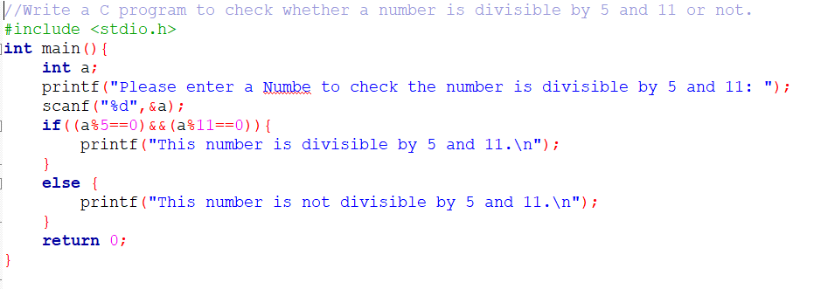
Problem 1:
Title: Write a C program to check whether a number is divisible by 5 and 11 or not.
Objectives:
To be familiar with scanf and printf function.
To be familiar with if else condition.
To be familiar with logical expression.
Input & Output:
At first, we have to read a value. Then check that is it divisible 5 & 11 or not. If it is divisible by 5 and 11 programme print This number is divisible by 5 & 11.
Or not the programme print This number is not divisible by 5 and 11.
Implementation:

Slide 3
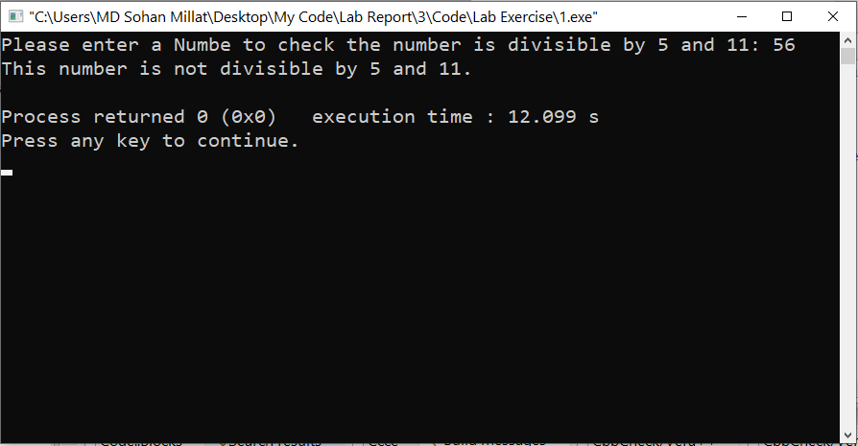
Test Result:
Discussion: I don’t face any problem solving this problem.
Problem 2:
Title: Write a C program to find maximum between three numbers.
Objectives:
To be familiar with scanf and printf function.
To be familiar with if else condition.
To be familiar with logical expression.
Input & Output:
At first, the programme read three value from user .. Then the programme compare three number with each other & find out the maximum number … Then it print the maximum number.

Slide 4
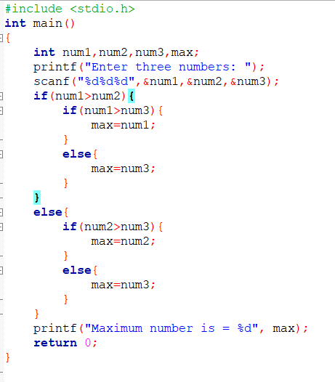
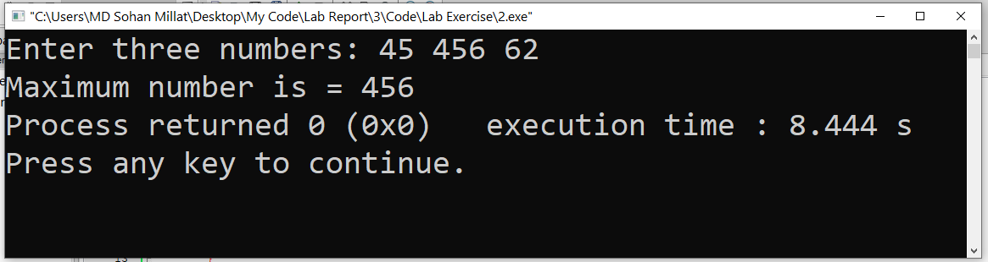
Implementation:
Test Result:
Discussion: When I solve this question I face the a problem. The programme doesn’t print the maximum value.Then I correct my code & solve the problem.

Slide 5
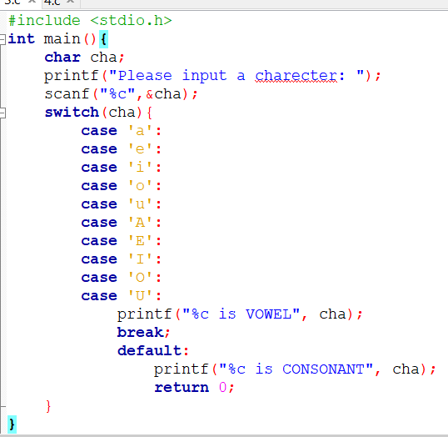
Problem 3:
Title: Write a Program to take the value from the user as input any alphabet and check whether it is vowel or consonant (Using the switch statement)
Objectives:
To be familiar with scanf and printf function.
To be familiar with switch case condition.
Input & Output:
This programme read a character from user and chek it is Vowel and consonant. If it is volwel programme print the massage on console “This is vowel”. Else it show that it is Consonant…
Implementation:

Slide 6
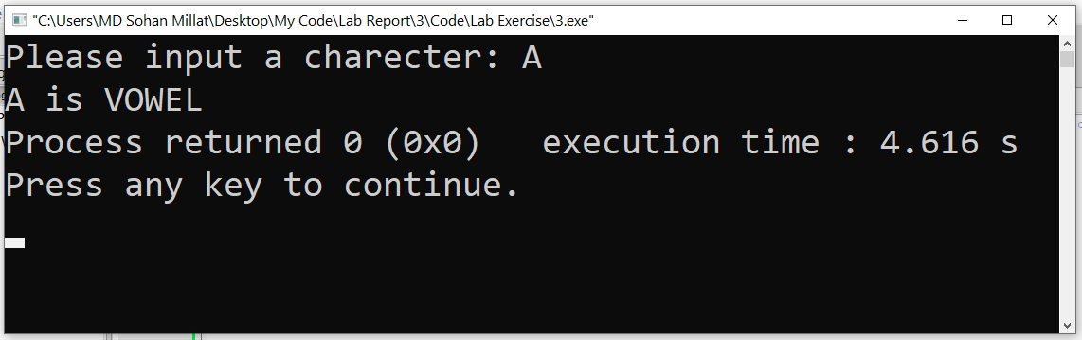
Test result:
Discussion: When I solve this problem I don’t face any problem.
Problem 4:
Title: Write a C program to check whether a year is leap year or not.
Objectives:
To be familiar with scanf and printf function.
To be familiar with if else condition.
To be familiar with logical expression.
Input & Output:
At first, the programme read a year from user. Then the programme check that the year is leap year or not. If the year is leap year the programme print in consol “This year is leap year.”. Else the programme print in console “This programme is not leap year.”

Slide 7
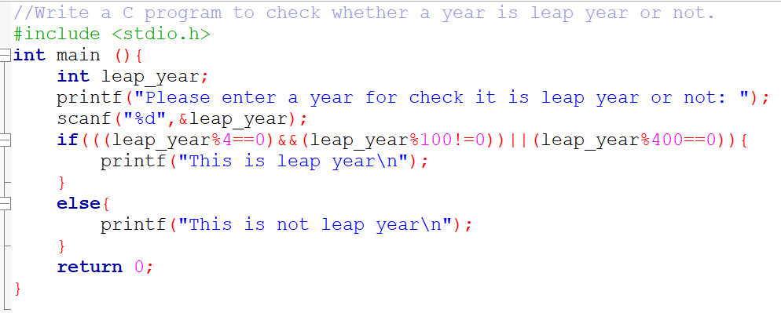
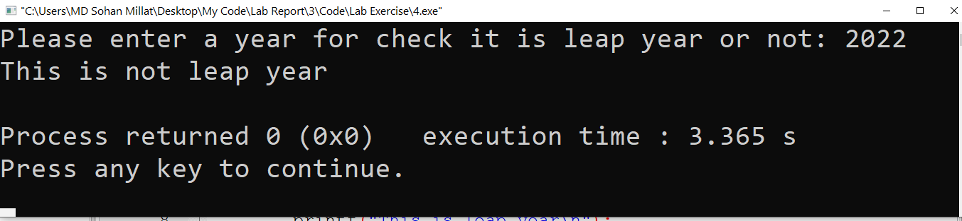
Implementation:
Test result:
Discussion: To solve this problem I don’t face any problem…

